Slide 1
1
Luís Ferreira
lufer@ipca.pt
June 2, 2025

Slide 2
Scope
Teach the essential of programming in Python
prerequisite: better if you know how to program in some other language
CodeAcademy http://www.codecademy.com/tracks/python
LearnPython http://www.learnpython.org/
[3]

Slide 3
Python
Why Python?
Useful for data processing
Concise language: express a lot in few lines of code
Short time to solution
Extensive standard library
Cross platform
Why not R
Key Comparisons
Anybody who comes to you and says he has a perfect language is either naïve or a salesman.
Bjarne Stroustrup
[3]

Slide 4
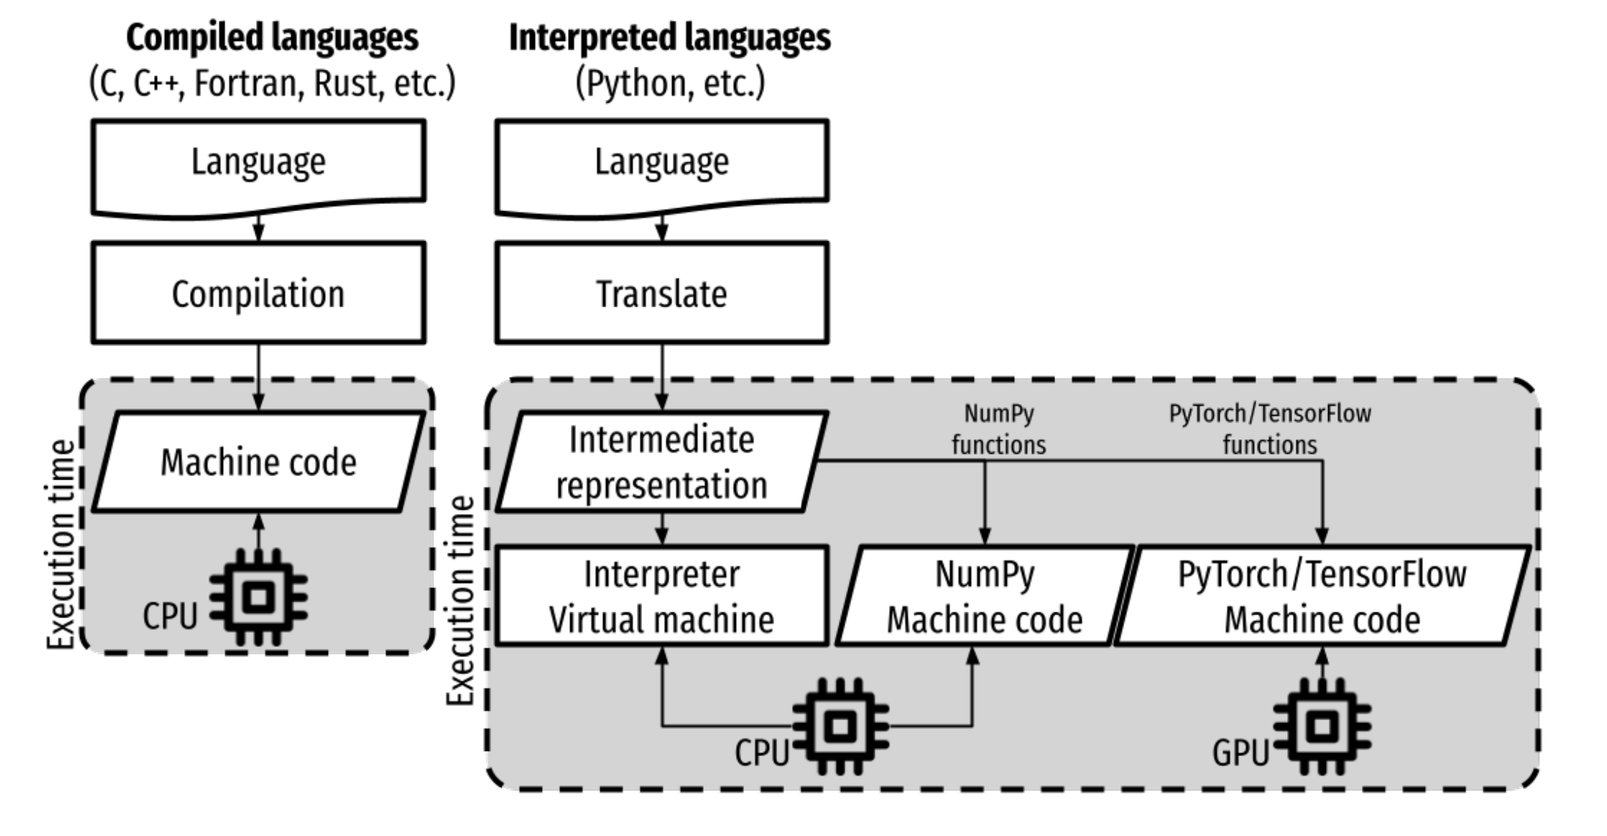
Python
Python Popularity:
https://trends.google.com/trends/explore?cat=31&date=all&q=python,R,matlab,spss,stata
Why Python?
Useful for data processing
Concise language: express a lot in few lines of code
Short time to solution
Extensive standard library
Cross platform
Why not R
[1]

Slide 5
Python vs R
Feature / Aspect | Python | R
Purpose | General-purpose programming language | Language primarily for statistical computing & graphics
Ease of Learning | Easy for beginners, readable syntax | Steeper learning curve, especially with statistical syntax
Community & Support | Large, diverse community (web, ML, data science) | Strong in academia and statistics communities
Statistical Analysis | Good, with packages like statsmodels, scipy | Excellent, with comprehensive built-in and package support
Machine Learning | Strong, with libraries like scikit-learn, TensorFlow | Good, with packages like caret, mlr, randomForest
Data Visualization | matplotlib, seaborn, plotly | ggplot2, lattice, shiny
Data Handling | pandas, numpy | data.frame, data.table, dplyr, tidyverse
IDE Support | VS Code, PyCharm, Jupyter | RStudio (best-in-class for R), Jupyter
Integration | Excellent (APIs, web apps, databases, cloud) | Good, especially with statistical tools and reports
Reporting & Dashboards | Dash, Jupyter Notebooks | Shiny, R Markdown
Performance | Generally faster, especially with optimized libraries | Slower for large-scale tasks without optimization
Extensibility | High – widely used in web, automation, ML, scripting | Moderate – more niche use outside data/statistics
Best For | Machine learning, automation, general software tasks | Statistical modeling, data exploration, academic research

Slide 6
Development Environment
Python Interpreter (python | python3)
Text Editor, IDE* or jupyter-notebook
Package Manager & Dependency Management (pip | Conda)
Virtual Environment Manager (venv)
Version Control System (git)
Debugger
Testing Framework
Documentation Tools
* IDE - Integrated Development Environment : Visual Studio Code, JupyterLab, Spyder

Slide 7
Development process
Using a python file
Write a python file (*.py)
Notepad++; Visual Studio Code; ex: file.py
Run the interpreter
python file.py
Interactively
C:\ python (Ctrl+D to quit or quit())

Slide 8
Clean Code
Category | Rule / Principle
Naming | - Use descriptive, meaningful names (user_id, not u)
 | - Use snake_case for variables/functions, CamelCase for classes
 | - Avoid abbreviations; be explicit
Functions | - Keep functions small and focused (do one thing only)
 | - Use descriptive names (prefer verbs: calculate_total)
 | - Limit number of arguments (prefer passing objects or named arguments)
 | - Avoid side effects unless clearly intended
Comments | - Write comments only when necessary – code should be self-explanatory
 | - Use docstrings ("""Describe purpose, args, returns""") for functions and classes
Code Structure | - Keep code DRY (Don't Repeat Yourself)
 | - Group related code (functions, classes) logically
 | - Follow PEP 8 for layout (indentation, spacing)

Slide 9
Clean Code
Category | Rule / Principle
Classes & Objects | - Use classes for related data/behavior
 | - Prefer composition over inheritance when possible
 | - Keep classes small; follow Single Responsibility Principle
Error Handling | - Use exceptions for exceptional cases
 | - Catch specific exceptions, not general except:
 | - Use with statements for resource management
Readability | - Write code as if the next person maintaining it is a psychopath who knows where you live
 | - Avoid clever tricks or overly compact syntax
Testing | - Write unit tests for critical logic
 | - Use pytest, unittest or similar frameworks
 | - Keep tests isolated and repeatable

Slide 10
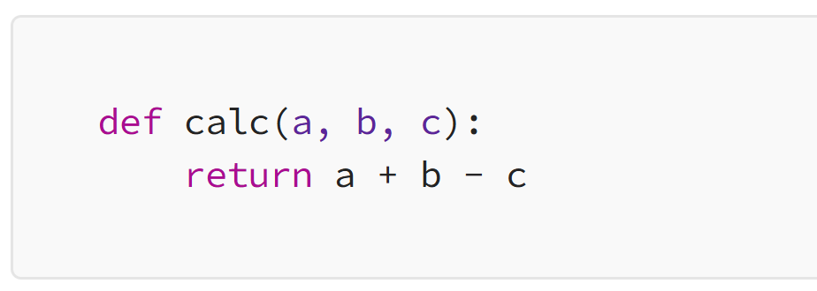

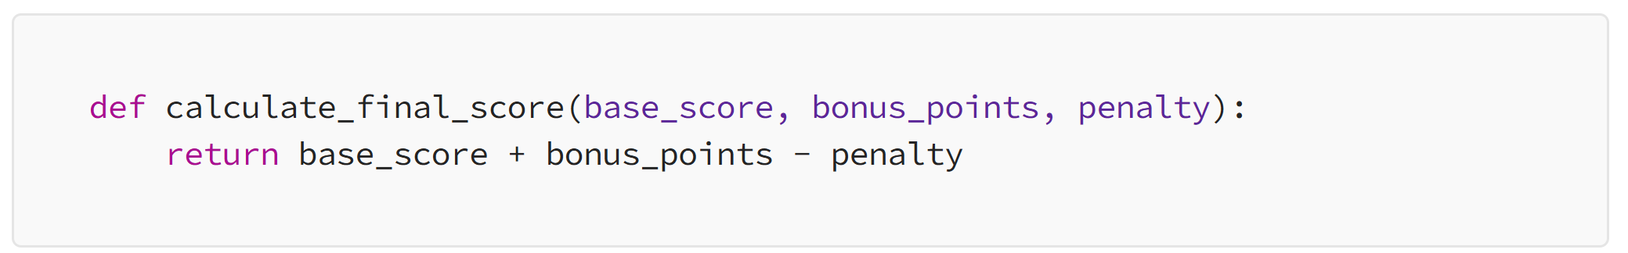

Clean Code
Variable and Function Names

Slide 11
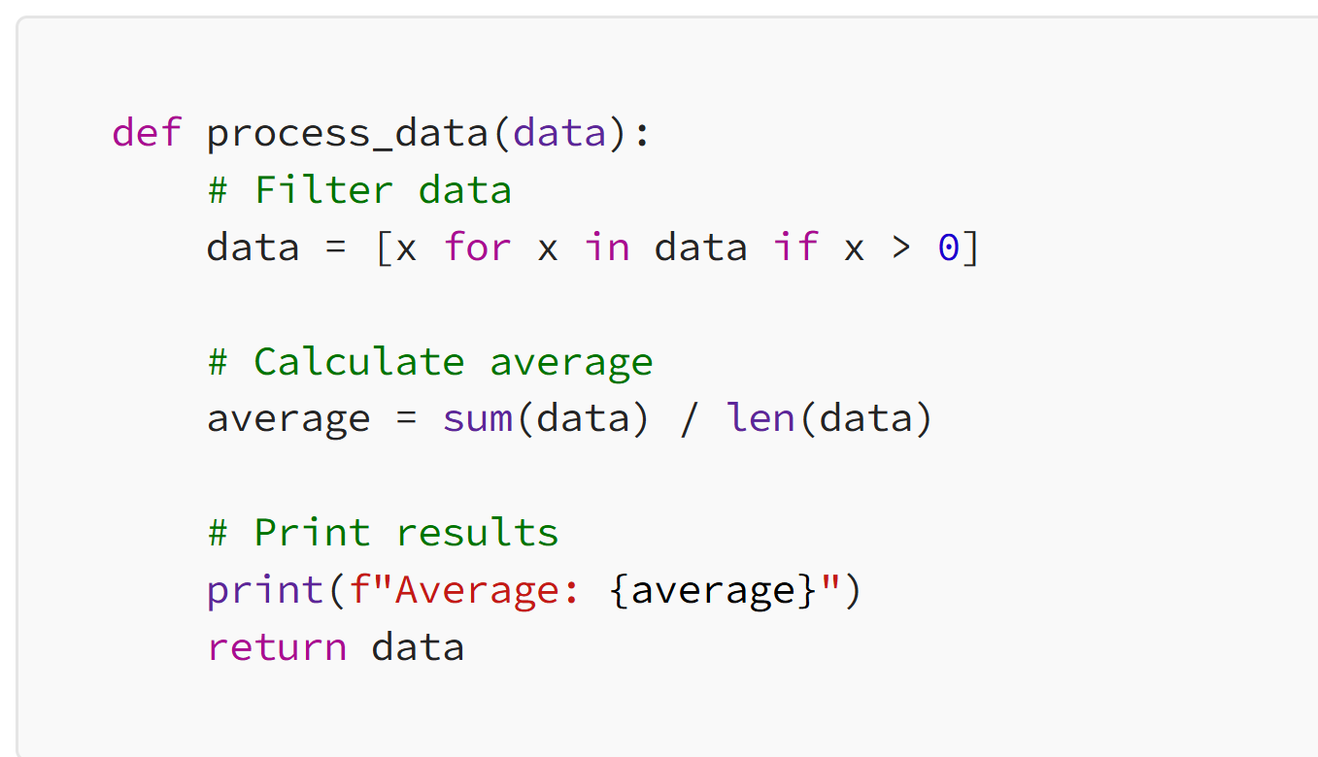
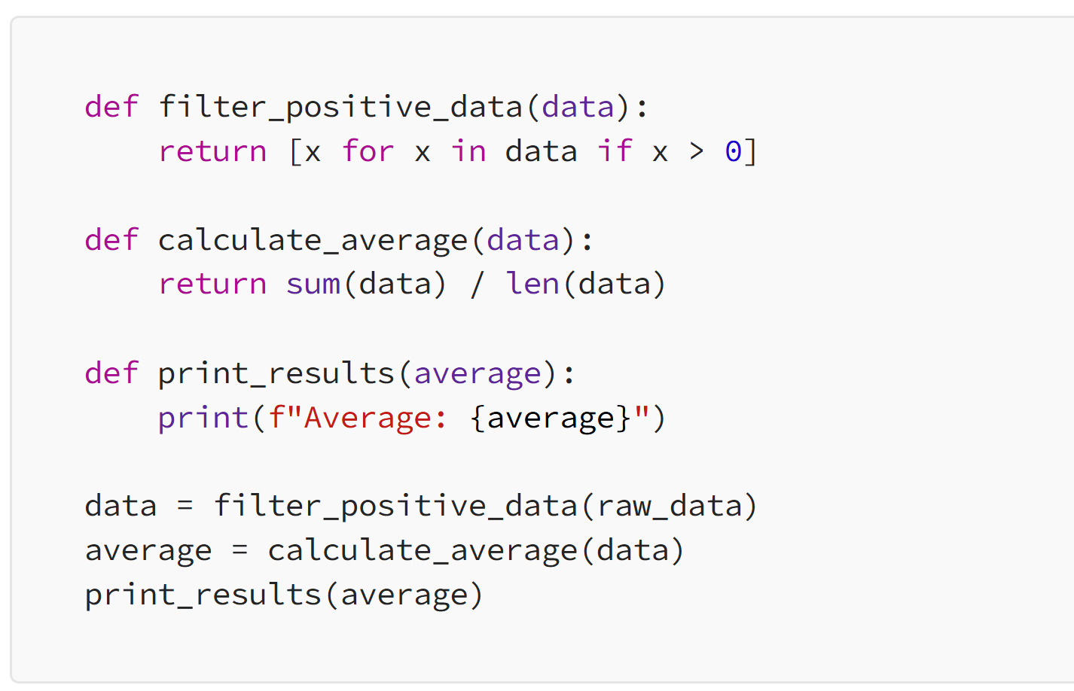
Clean Code
SOLID - Single Responsibility Functions

Slide 12
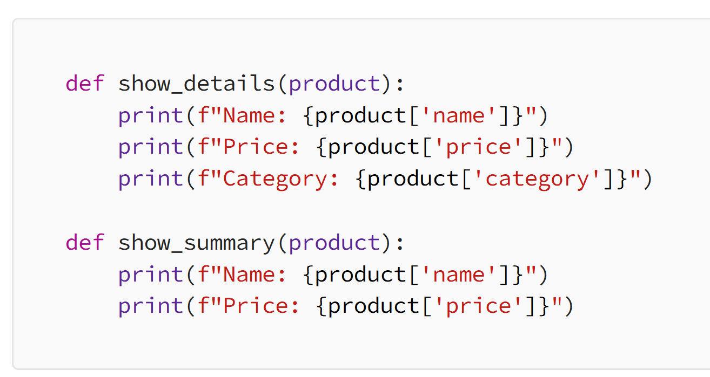
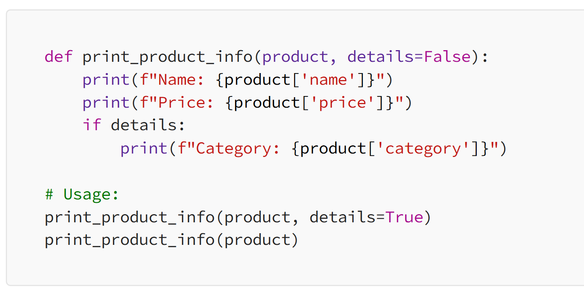
Clean Code
Duplicated Code

Slide 13
Python documentation
Documenting versus “Commenting”
Documentation interests for those who wants to use the code (as libraries, modules, etc.), mainly!
Commenting interests for the owner of the code or others that wants to continue developing it, manly!
[2]

Slide 14
Python documentation
Documenting and “Commenting”
Code Maintainability
Onboarding New Developers
Code Collaboration
Quality Assurance
[2]

Slide 15
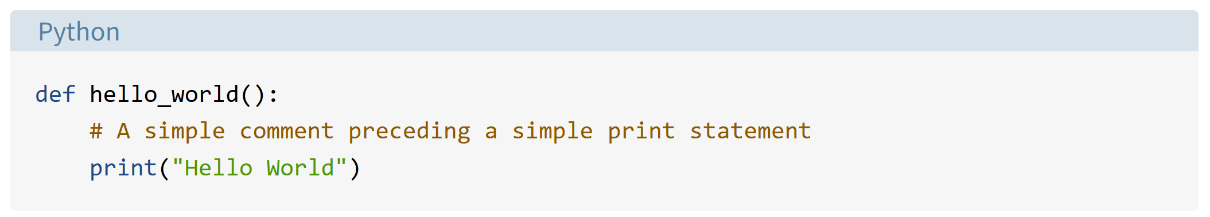
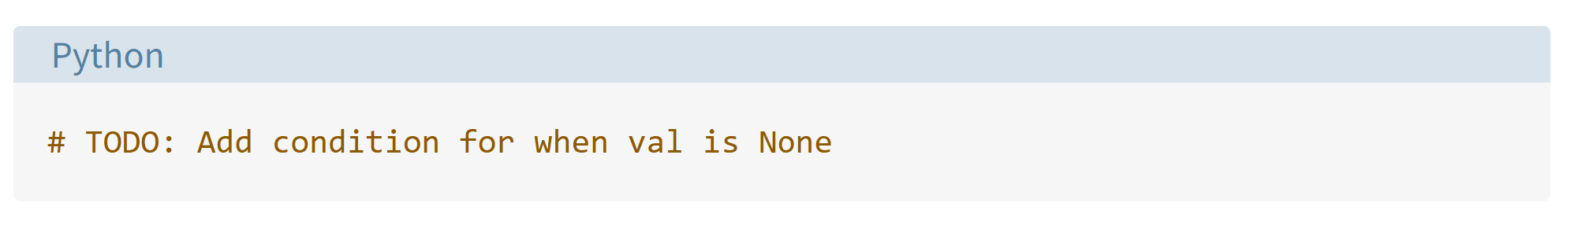
Python documentation
“Commenting”
[2]

Slide 16
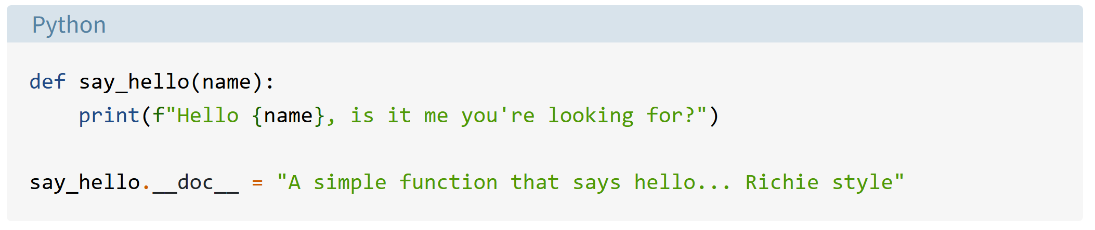
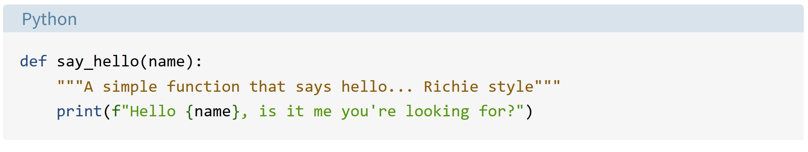
Python documentation
Documenting
[2]

Slide 17
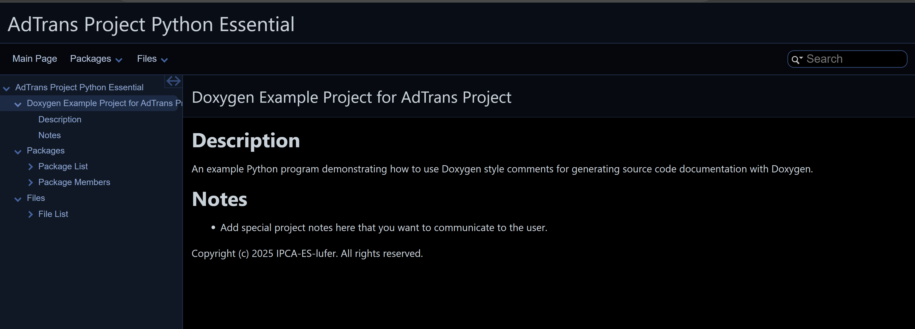
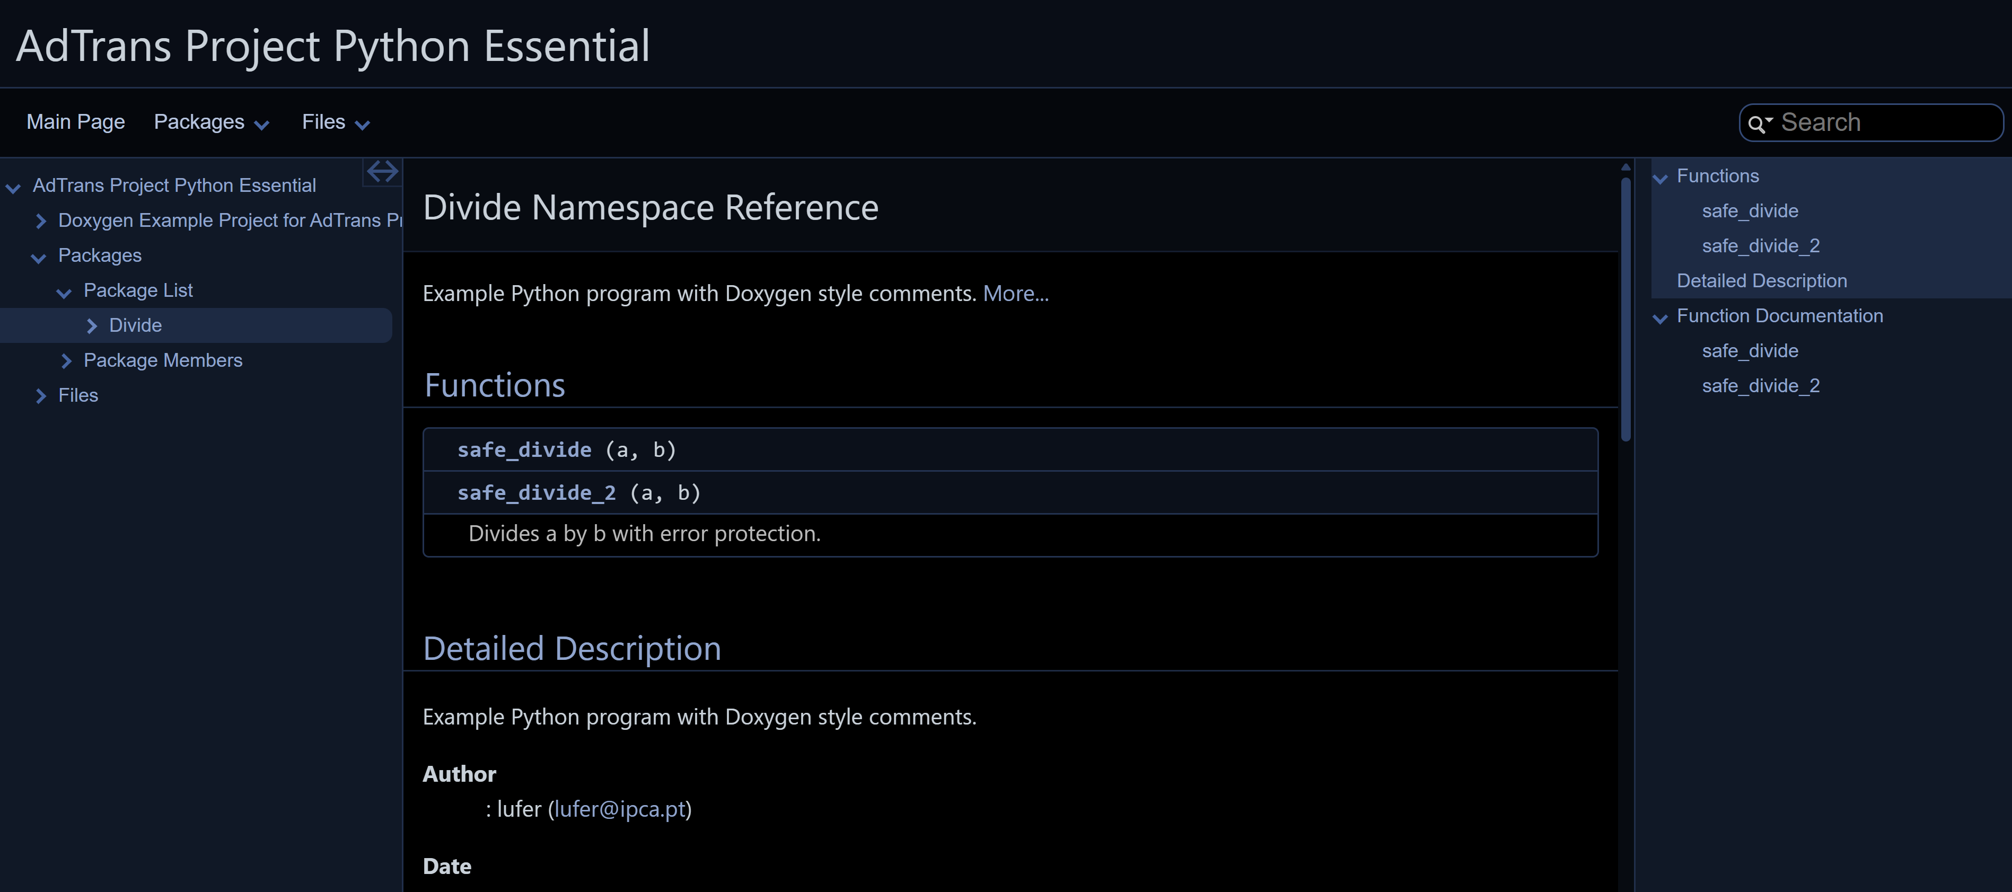
Python documentation
HTML documentation of the python code (generated by Doxygen)

Slide 18
References
[1] - Statistics and Machine Learning in Python, Release 0.8, Edouard Duchesnay, Tommy Löfstedt, Younes Feki
[2] - Documenting Python Code: A Complete Guide - https://realpython.com/documenting-python-code/
[3] - PRACE Winter School 2019 - Python for data processing & analysis, KU Leuven ICTS, Geert Jan Bex, March 4-8, 2019,
[4] - Automate the Boring Stuff with Python, Al Sweigart, https://automatetheboringstuff.com/
[5] - Jupyter Notebook Tips, Tricks, and Shortcuts, https://www.dataquest.io/blog/jupyter-notebook-tips-tricks-shortcuts/

